Slide 1







Exploring Technology Job Demand
Matthew Cwynar>
1/31/2023

Slide 2



OUTLINE
Executive Summary
Introduction
Methodology
Results
Visualization – Charts
Dashboard
Discussion
Findings & Implications
Conclusion
Appendix

Slide 3

EXECUTIVE SUMMARY
KPIs in programing languages and databases
Demographic data
Technology discrepancies by country
Gender issues

Slide 4

INTRODUCTION
About: Comprehensive analysis of tech job markets
Purpose:
Most in demand skills
Top programming languages
Databases
Useful IDEs
Audience: HR heads and tech workers

Slide 5

METHODOLOGY
Sources
Programming languages for development
Developer Survey 2019
Job Postings
Data analysis
Cleaning
Visualization
Presentation

Slide 6
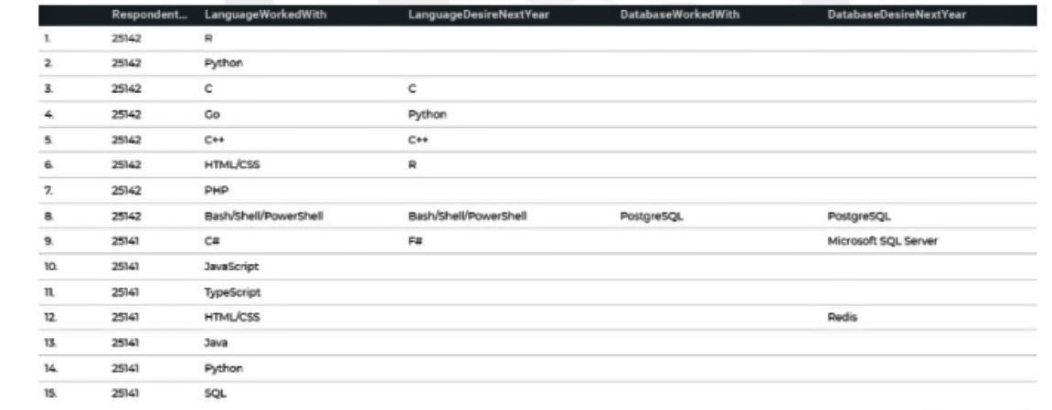
RESULTS

Slide 7
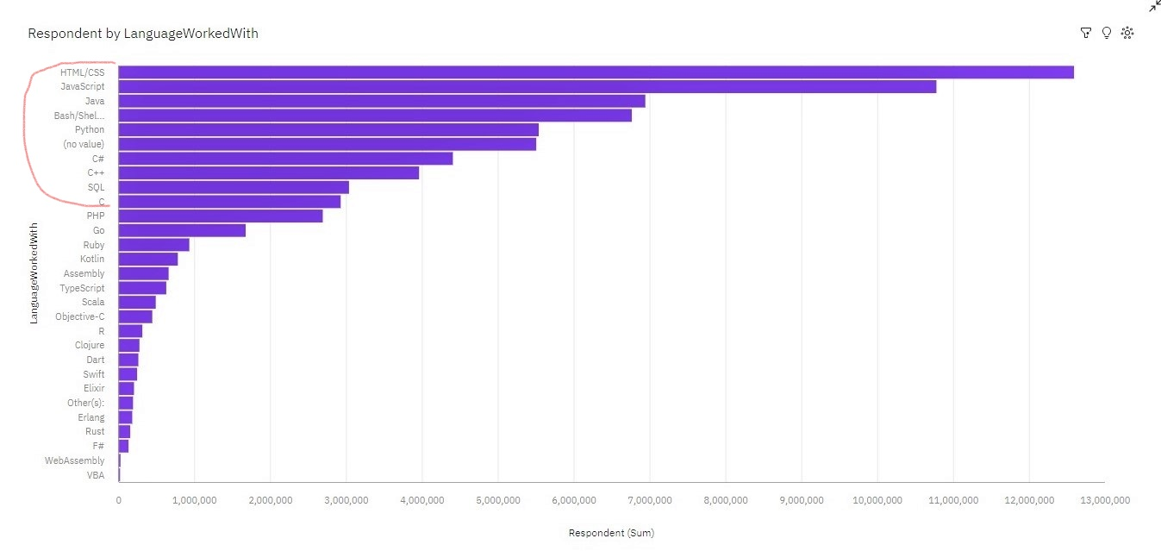
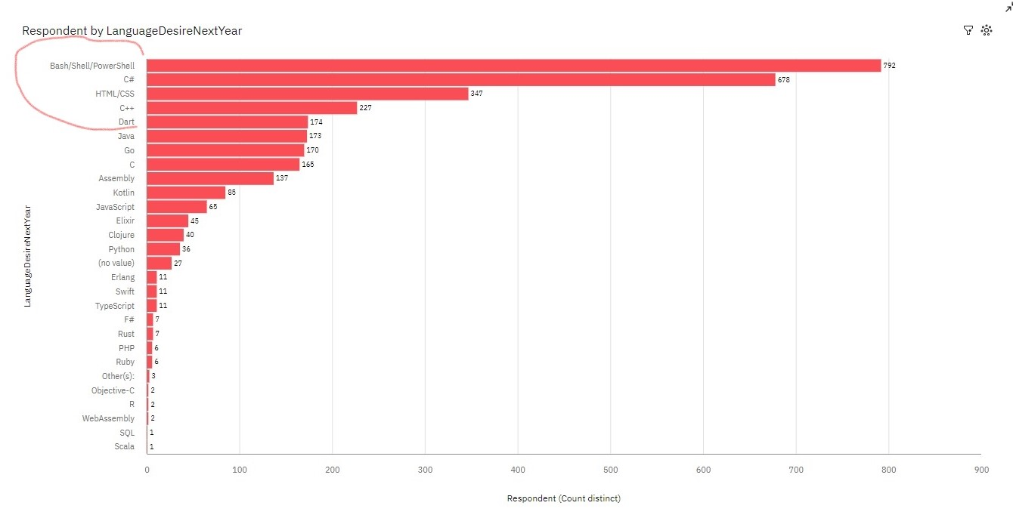
PROGRAMMING LANGUAGE TRENDS
Current Year
Next Year

Slide 8
PROGRAMMING LANGUAGE TRENDS - FINDINGS & IMPLICATIONS
Findings
HTML/CSS, Java, Python, C#, SQL are top 5 right now
Bash/Shell/Powershell, HTML/CSS, Dart, Go, Assembly will be most in demand next year
Bash/Shell/Powershell are more efficient to automate programming tasks of shell on Windows
Implications
HTML/CSS remains widely used
More robust programming languages such as GO, Assembly and Dart are preferred
Why? Makes job easier to do and efficient

Slide 9
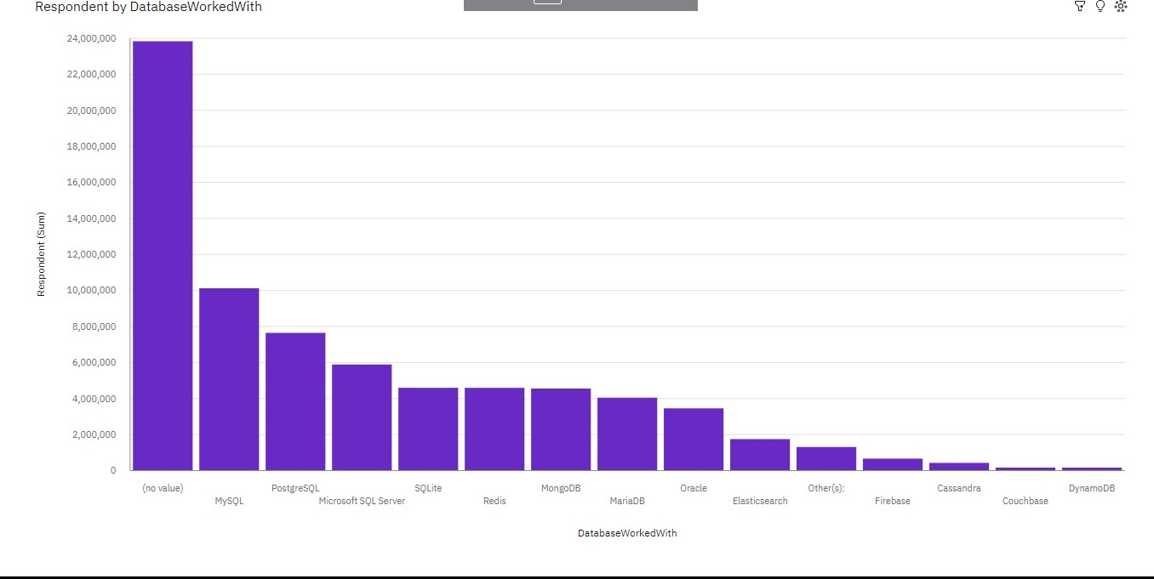
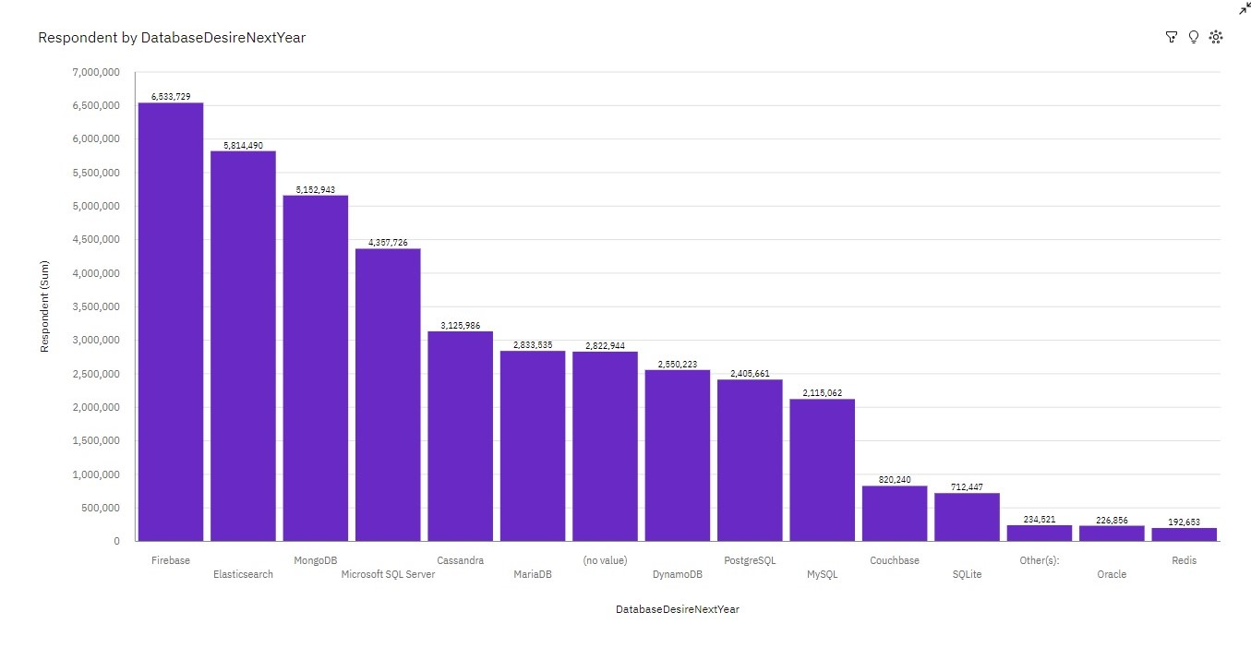
DATABASE TRENDS
Current Year
Next Year

Slide 10
DATABASE TRENDS - FINDINGS & IMPLICATIONS
Findings
MySQL is most popular
Firebase and Elasticsearch will replace MySQL
Microsoft SQL stays about the same
Implications
-Open source databases still used
-Tech evolving to more efficient databases
-Oracle drops for lack of potential use

Slide 11

DASHBOARD
https://us3.ca.analytics.ibm.com/bi/?perspective=dashboard&pathRef=.my_folders%2FNew%2Bdashboardjm&action=view&mode=dashboard&subView=model000001860463e031_00000002

Slide 12
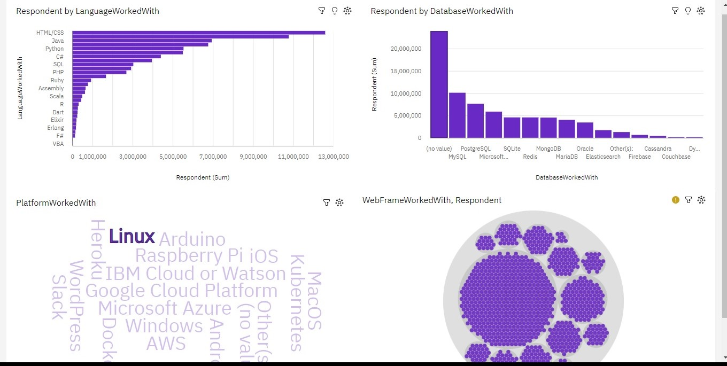
DASHBOARD TAB 1
Screenshot of dashboard tab 1 goes here

Slide 13
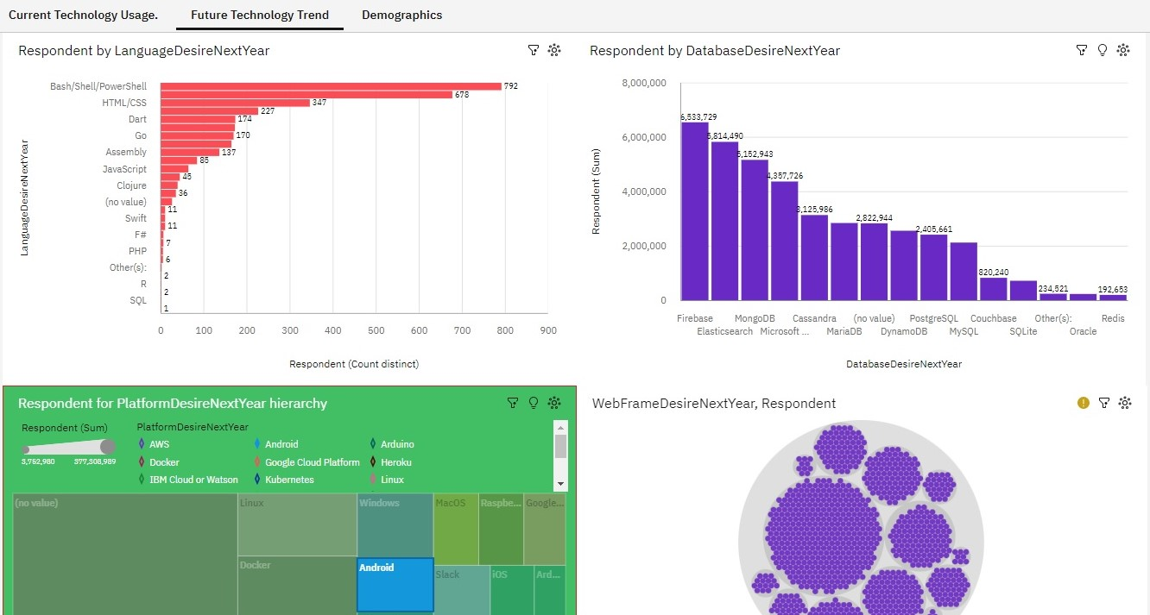
DASHBOARD TAB 2
Screenshot of dashboard tab 2 goes here

Slide 14
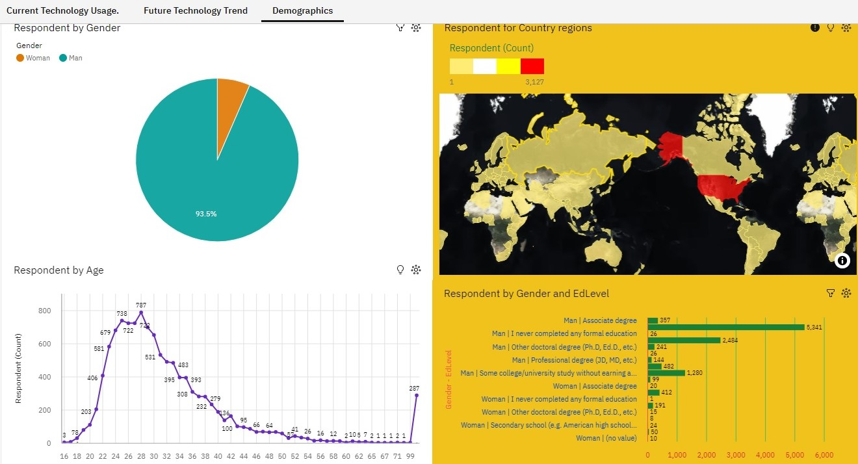
DASHBOARD TAB 3
Screenshot of dashboard tab 3 goes here

Slide 15
DISCUSSION
Promote gender diversity in tech
Investment in training for new skills
Improve technology availability for developing countries
Create a more equal opportunity workforce

Slide 16
OVERALL FINDINGS & IMPLICATIONS
Findings
Fast growing tech
Gender gap in tech
Concentrated areas in USA
Need more development in marginalized countries
Implications
Companies need to evolve with tech
More efficient processes to speed apps and cloud for the future
Demand for jobs will easier to fill

Slide 17

CONCLUSION
Current tech trends and the next year
Programming languages, database respondents and demographics
Incorporate technology and training into diverse workforce to keep up with high demand and workflows

Slide 18
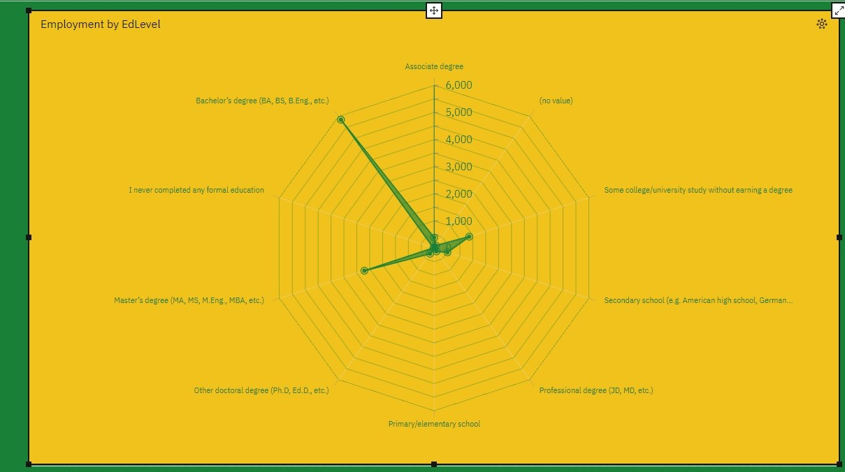
APPENDIX

Slide 19
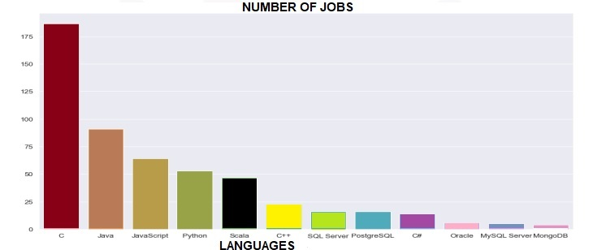
JOB POSTINGS

Slide 20
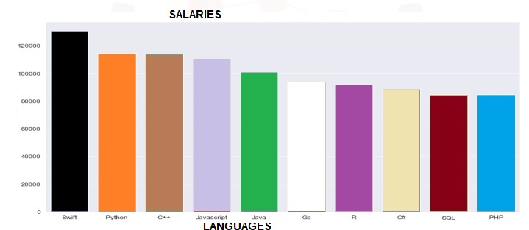
POPULAR LANGUAGES

